Slide 1


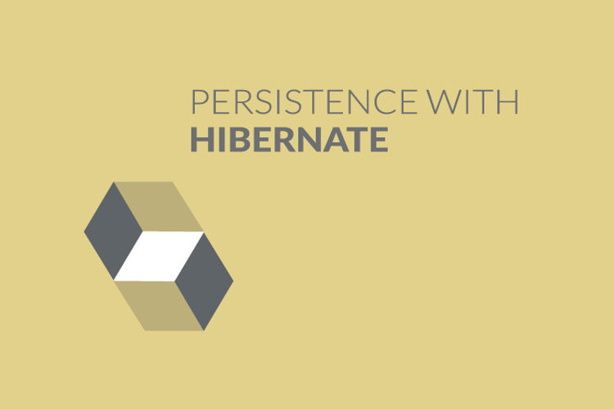
Table Relationships-Part 2
Chapter 29

Slide 2
Today’s Agenda
Table RelationShips-Part 2
Selecting Records From Join Tables
Selecting Single Record
Selecting All Records
Fetching Strategies

Slide 3
Selecting Records
We can select records in One To Many relationship in 2 ways, as stated below.
Selecting single parent object and its associated child objects
Selecting all parent objects and their associated child objects

Slide 4
Selecting Records
In both the cases , we will either use Hibernate’s get() , load() or list() methods to fetch just the parent object .
And , Hibernate will automatically fetch the associated child objects for us.

Slide 5
OneToManySelect.java
Department dobj =sess.get(Department.class, 101);
if(dobj!=null)
{
System.out.println(dobj.getDeptno()+"\t"+dobj.getDname());
Set staff=dobj.getStaff();
for(Object o:staff)
{
Employee e=(Employee)o;
System.out.println(e.getEmpNo()+"\t"+e.getEmpName());
}
}

Slide 6
OneToManySelectAll.java
Query<Department> qry=sess.createQuery("from Department");
List <Department>dlist=qry.list();
for(Department dobj:dlist)
{
System.out.println(dobj.getDeptno()+"\t"+dobj.getDname());
Set <Employee>staff=dobj.getStaff();
for(Employee e:staff)
{
System.out.println(e.getEmpNo()+"\t"+e.getEmpName());
}
}

Slide 7
A Very Important Point!
If we closely observe the SQL queries generated by these codes , we will notice something very important.
The important point is that Hibernate fetches the child table data from the database only when we try to retrieve associated child object of the current parent object.

Slide 8
A Very Important Point!
For example , in our case , Hibernate will at first fetch only the department object from the database .
But , when we will retrieve Employee objects from the Set in the for each loop , only then Hibernate will try to fetch the Employee objects from the database.
This means that it will run multiple SELECT queries

Slide 9
Why Is It So ?
It is because of Hibernate’s Fetching Strategy , which is of two types :
Eager Loading:in which data initialization occurs on the spot
Lazy Loading: which is used to defer initialization of an object as long as it's possible.
By default Hibernate uses Lazy loading

Slide 10
Changing Fetching Strategy
It is set automatically in the mapping file of the parent class as the value “select” of the attribute fetch belonging to the <set> tag.
However we can change it to “join” as shown below:
<set name="staff" cascade="all" fetch=“join”>
<key column="dno" />
<one-to-many class="in.scabhopal.hibernate.Employee" />
</set>

Slide 11
Changing Fetching Strategy
If we do this then Hibernate will use only one SELECT query to fetch both parent and child objects.
This SELECT query will be a JOIN query

Slide 12
Advantages Of Lazy Loading
Initial load time is much smaller than in the other approach
Less memory consumption than in the other approach

Slide 13
Disadvantages Of Lazy Loading
Delayed initialization might impact performance during unwanted moments
In some cases we need to handle lazily-initialized objects with a special care or we might end up with an exception

Slide 14
Advantages & Disadvantages Of Eager Loading
Advantages:
No delayed initialization related performance impacts
Disadvantages:
Long initial loading time
Loading too much unnecessary data might impact performance

